Slide 1
Social Media Analytics Homophily vs. Social Influence MSBA, S2022, Feb 21
Dr. Anitesh Barua
David Bruton Jr. Centennial Chair Professor of Business
Distinguished Fellow, INFORMS Information Systems Society
Stevens Piper Foundation Professor
University of Texas Distinguished Teaching Professor
Associate Director, Center for Research in e-Commerce
McCombs School of Business, University of Texas at Austin
Email: aniteshb@gmail.com

Slide 2
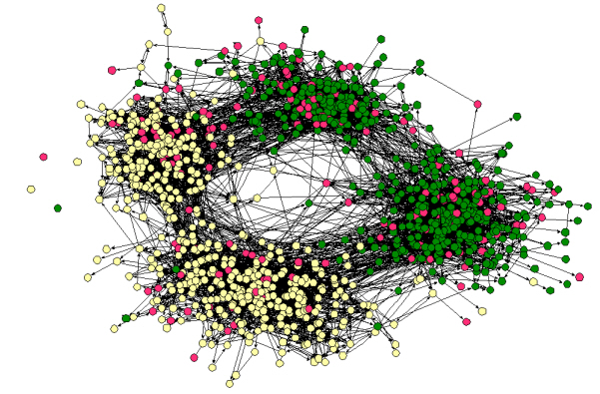
Homophily (Similarity)
“Birds of a feather flock together”
Your friends/contacts vs. a random sample of people
Social networks tend to connect people who are similar to each other
Friendships by race and across a middle and a high school in the same school district
Source: Easley & Kleinberg

Slide 3
Distinguishing Between Social Influence and Homophily
Can opinions, attitudes & purchases be attributed to social influence?
Or is it due to homophily?
E.g., did I buy something because
you influenced me?
we are just similar?
What difference would it make to a company’s strategy?

Slide 4


Detecting Homophily for Static Attributes
Have to know what attribute(s) may be relevant
E.g., gender, interest, educational background, etc.
G
B
F
C
Jocks
I
A
Nerds
H
E
D
Does this network exhibit homophily?
What measure can we use?
Source: Easley & Kleinberg

Slide 5
A Little Theoretical Detour
$$A network with a set of nodes \left(V\right) \& randomly assigned edges \left(E^{r}\right):$$
$$R=\left(V, E^{r}\right)$$
Each node is assigned an attribute: say, type = jock with probability p, and type = nerd with probability q = 1-p
Consider any edge (i,j) ∈ E^{r} of this random network R.
Let the random variable X_{ij} = 1 if it is a “cross-edge”, and X_{ij} = 0 otherwise. Then X_{ij} is a Bernoulli random variable such that
P(X_{ij} = 1) = 2pq
p
q = (1-p)
Jock on the left, nerd on the right
q = (1-p)
p

Slide 6
Dynamic Attributes: How Can We Distinguish Between Homophily & Influence?
Need multiple snapshots in time
Homophily: Due to similar attributes in time t, some people may choose to become friends in t+1
E.g., high achievers in a class may form links
But some people may become friends in t+1 even though their attributes were different in t
Check which effect is stronger
Source: LaFond & Neville

Slide 7
Test for Homophily
Homophily exists if
p(Becoming friends in t+1 where attributes were same in t) > p(Becoming friends in t+1 where attributes were different in t)
p(Dissolving friendships in t+1 where attributes were same in t) < p(Dissolving friendships in t+1 where attributes were different in t)
Source: LaFond & Neville

Slide 8
Detecting Social Influence
Some friends at t with different attributes may become similar in t+1 (due to social influence)
E.g., some buy a product their friends have
Some change their beliefs & attitudes
But people who are not friends and have different attributes at t can also become similar at t+1 due to “other” factors
Which effect is stronger?
I.e., is p(Attributes becoming same in t+1 where the individuals were friends in t) > p(Attributes becoming same in t+1 where the individuals were not friends in t)?
Is p(Attributes becoming different in t+1 where the individuals were friends in t) < p(Attributes becoming different in t+1 where the individuals were not friends in t)?
Source: LaFond & Neville

Slide 9
Distinguishing Between Homophily & Social Influence: The Case of Dynamic Attributes
G
C
G
B
B
C
A
F
F
A
E
E
D
D
Time: t t+1
 | Subscription
A | Yes
B | No
C | No
D | Yes
E | No
F | Yes
G | Yes
A | Yes
B | Yes
C | Yes
D | Yes
E | No
F | Yes
G | Yes
Attribute (e.g.,
subscription
to a music service
at time t
Attribute
at time t+1

Slide 10
Evidence of Homophily Versus Social Influence
G
C
G
B
G
B
C
A
B
C
F
F
A
F
A
E
Influence
E
D
D
Influence
D
E
Time: t t+1 t+2
Homophily
Homophily
A | Yes
B | No
C | No
D | Yes
E | No
F | Yes
G | Yes
A | Yes
B | Yes
C | Yes
D | Yes
E | No
F | Yes
G | Yes
Attribute
at time t
Attribute
at time t+1
Attribute
at time t+2

Slide 11
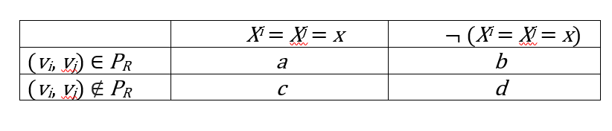
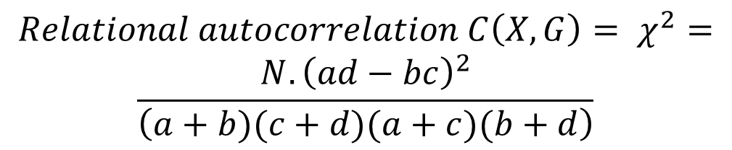

Testing Significance Levels
$$X^{i} is an atttribute of node v_{i}$$
$$P_{R} is a set of related nodes \left(friends\right) in a network$$
$${Relational autocorrelation C\left(X, G\right)= χ}^{2}=$$
$$\frac{N.{\left(ad−bc\right)}^{2}}{\left(a+b)(c+d)(a+c)(b+d\right)}$$
Source: LaFond & Neville

Slide 12
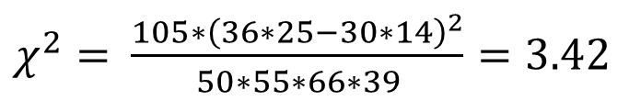

Chi-Square (for Contingency Tables)
 | Improved Outcome | Didn’t improve | Total
Treatment | 36 | 14 | 50
No Treatment | 30 | 25 | 55
Total | 66 | 39 | 105
$χ^{2}=$ $?$
$χ^{2}=$ $\frac{105∗{\left(36∗25−30∗14\right)}^{2}}{50∗55∗66∗39}=3.42$

Slide 13
Significance Tests
Homophily: C(X_{t} , G_{t+1}) > C(X_{t} , G_{t})
Social influence: C(X_{t+1} , G_{t}) > C(X_{t} , G_{t})

Slide 14
Not all Networks are
Created Equal
Possibility 1:
No social influence, no homophily
Possibility 2:
Social influence but no homophily
Possibility 3:
Homophily but no social influence
4th possibility (not shown): Both influence
& homophily

